Slide 1


By
Zainab Abdullahi Imam
26/9/2024

Slide 2

Outline
Executive Summary
Introduction
Methodology
Results
Conclusion
Appendix

Slide 3
Executive Summary
Summary of methodologies
Data Collection
Data Wrangling and Analysis
Interactive Maps
Summary of all results
Data Analysis and Visualization
-> Best model?

Slide 4
Introduction
Project background and context
Is SpaceX rocket Falcon 9 going to land successfully?
Problems you want to find answers
Which factors influence the landing
What are the best conditions for the best result

Slide 5

Section 1

Slide 6
Methodology
Executive Summary
Data collection methodology:
Data was collected using SpaceX API and wikipedia
Perform data wrangling
one hot encoding was done
Perform exploratory data analysis (EDA) using visualization and SQL
Scatter/Box/Pie charts for visual pattern
Perform interactive visual analytics using Folium and Plotly Dash
using Folium and Plotly Dash
Perform predictive analysis using classification models
using regression and tree techniques

Slide 7
Data Collection
Describe how data sets were collected.
Data was collected via API/Wikipedia, it was then transformed and exported, the data was saved to a csv format
You need to present your data collection process use key phrases and flowcharts
Data from API/Wikipedia
Transform Data into Dataframe
Export
Data

Slide 8
Data Collection – SpaceX API
Present your data collection with SpaceX REST calls using key phrases and flowcharts
Add the GitHub URL of the completed SpaceX API calls notebook (must include completed code cell and outcome cell), as an external reference and peer-review purpose
https://github.com/ademipeju/Course_10_capsone_project.git
Place your flowchart of SpaceX API calls here
Establish connection to spaceX-API via request
Transform data(.json) into table/dataframe
Clean/filter dataframe
Export to (.csv)file

Slide 9
Data Collection - Scraping
Present your web scraping process using key phrases and flowcharts
Add the GitHub URL of the completed web scraping notebook, as an external reference and peer-review purpose
Place your flowchart of web scraping here
Establish connection to spaceX-API via request
Transform data(.json) into table/dataframe
Clean/filter dataframe
Export to (.csv)file

Slide 10
Data Wrangling
Load data in data frame
Data cleaning
Simplify to Boolean values
Describe how data were processed
After loading the data, I checked for missing values which I replaced with the mean of the column of interest, type casting was done, null values were dropped.
You need to present your data wrangling process using key phrases and flowcharts
Add the GitHub URL of your completed data wrangling related notebooks, as an external reference and peer-review purpose
https://github.com/Zainab/Course_10_capsone_project.git

Slide 11
EDA with Data Visualization
Summarize what charts were plotted and why you used those charts
Several charts were plotted, including line chart, scatter plot, and pie charts. This was done to establish relationship between the features
Add the GitHub URL of your completed EDA with data visualization notebook, as an external reference and peer-review purpose
https://github.com/Zainab/Course_10_capsone_project.git

Slide 12
EDA with SQL
Using bullet point format, summarize the SQL queries you performed
General overview over available landsides, in particular whose five entries who start with 'CCA'
Number of successful/failed mission outcome
List for failed ones in 2015
List first successful landing outcome in drone ship
Specify, count and rank outcomes between ~2010 and ~2017
Average Payload per booster version 'F9v1.1'/Total for boosters carried by NASA (CRS)
Booster version with maximal payload
Names of boosters with successful ground pad and certain payload

Slide 13
Build an Interactive Map with Folium
Summarize what map objects such as markers, circles, lines, etc. you created and added to a folium map
I added map icons, circle markers and lines
Explain why you added those objects
This was done to draw insight as to wether the landing was a success or a failure
Add the GitHub URL of your completed interactive map with Folium map, as an external reference and peer-review purpose
https://github.com/Zainab/Course_10_capsone_project.git

Slide 14
Build a Dashboard with Plotly Dash
Summarize what plots/graphs and interactions you have added to a dashboard
Selection of Launch Site
Pie charts for relation percentage based on launch site
Scatter graphs for correlation between payload and success based on launch site
Explain why you added those plots and interactions
To visualize the effectiveness of launch site and payload mass
Add the GitHub URL of your completed Plotly Dash lab, as an external reference and peer-review purpose
https://github.com/zainab/Course_10_capsone_project.git

Slide 15
Predictive Analysis (Classification)
Building
Evaluation and improvement
Conclusion
Check for accuracy via R-score and
Confusion matrix
Depending on accuracy, choose
Best model.
Standadizes transform data
Split data into training and testing
Search for best score parameters
For ML
Using training set,
Initialize diff ML algorithms

Slide 16
Results
Exploratory data analysis results
Interactive analytics demo in screenshots
Predictive analysis results

Slide 17

Section 2

Slide 18
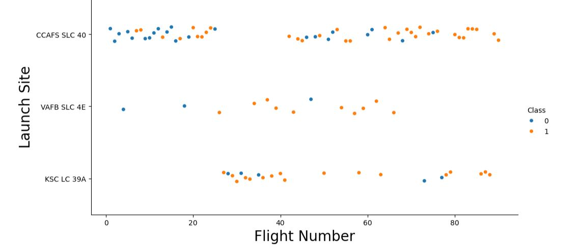
Flight Number vs. Launch Site
Show a scatter plot of Flight Number vs. Launch Site
First ~25 Starts, in particular. at CCAFS SLC 40 were mostly failures
Starts at KSC LC 39A gave them the information for success
VAFB SLC 4E with most successful launches
Show the screenshot of the scatter plot with explanations

Slide 19
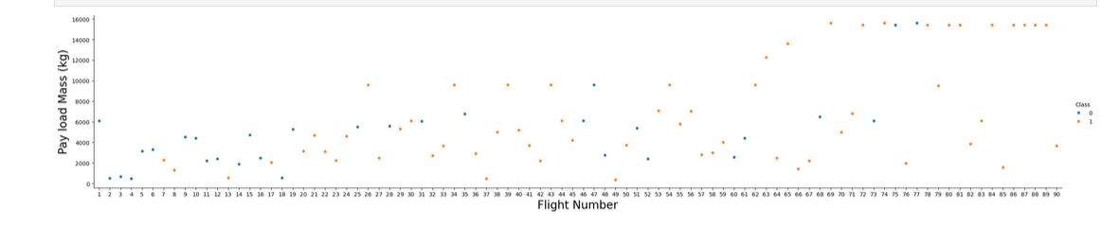
Payload vs. Launch Site
Show a scatter plot of Payload vs. Launch Site
After successfully establish a launch with low mass ~7500kg,
Launches with higher payload masses were almost always successful
Show the screenshot of the scatter plot with explanations

Slide 20
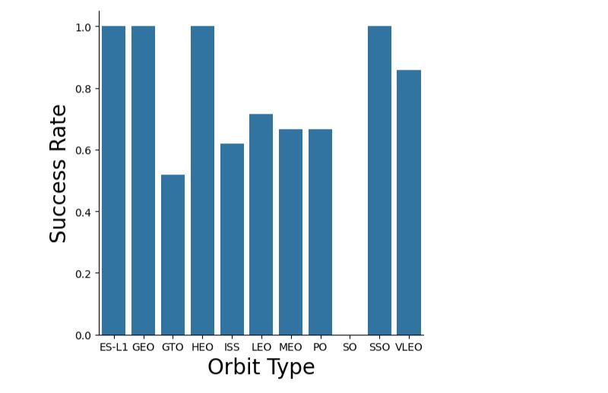
Success Rate vs. Orbit Type
Show a bar chart for the success rate of each orbit type
Launches onto SO were disastrous (only one launch)
ES-L1, GEO, HEO and SSO with success only
Show the screenshot of the scatter plot with explanations

Slide 21
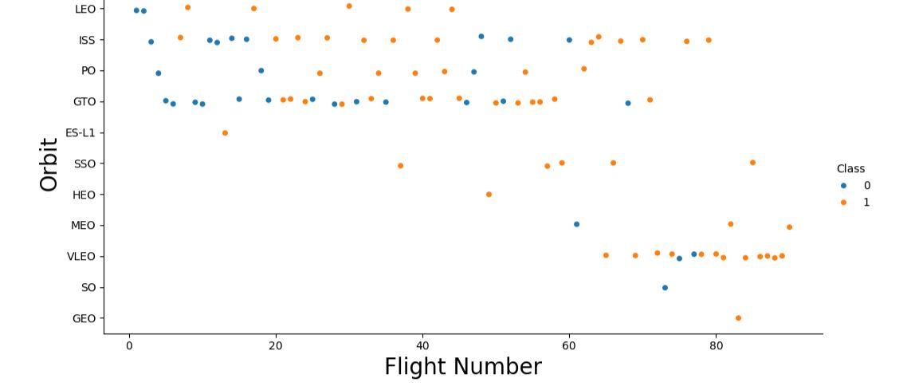
Flight Number vs. Orbit Type
Show a scatter point of Flight number vs. Orbit type
At the beginning, testing on four selected orbits
ISS and GTO gave them a breakthrough after flight number ~ 20
After flight number ~ 60 also focused on other orbits, in particular on VLEO
Show the screenshot of the scatter plot with explanations

Slide 22
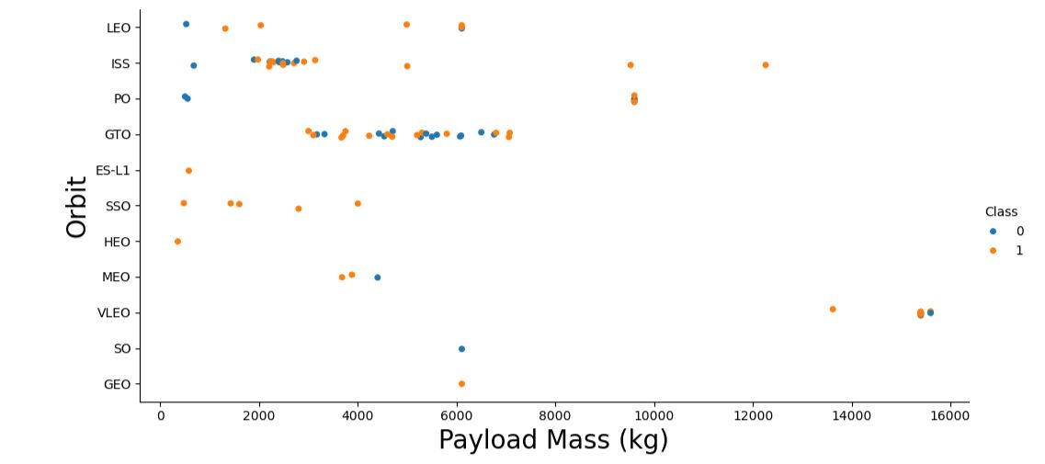
Payload vs. Orbit Type
Show a scatter point of payload vs. orbit type
Started mostly with ~2500-
7500kg
Launches with higher payload > 7500kg rather successful
Show the screenshot of the scatter plot with explanations

Slide 23
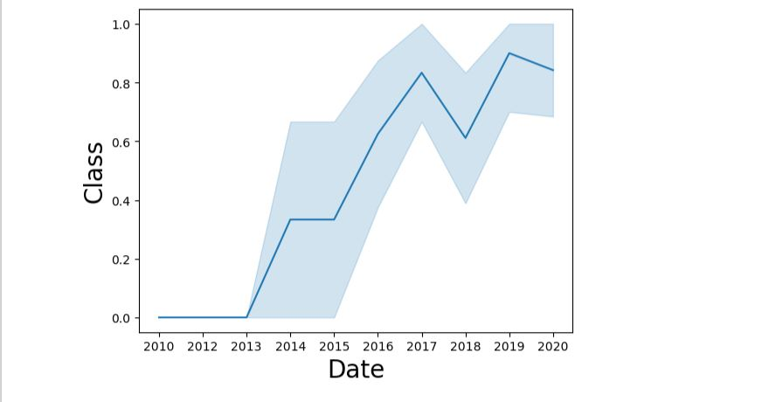
Launch Success Yearly Trend
Show a line chart of yearly average success rate
Since 2013 mostly improving
For 2017 mostly >80%
except for Dip in Success in 2018
Show the screenshot of the scatter plot with explanations

Slide 24
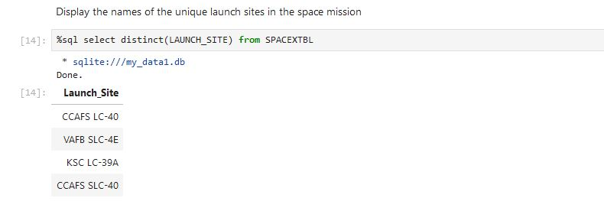
All Launch Site Names
Find the names of the unique launch sites
Present your query result with a short explanation here

Slide 25
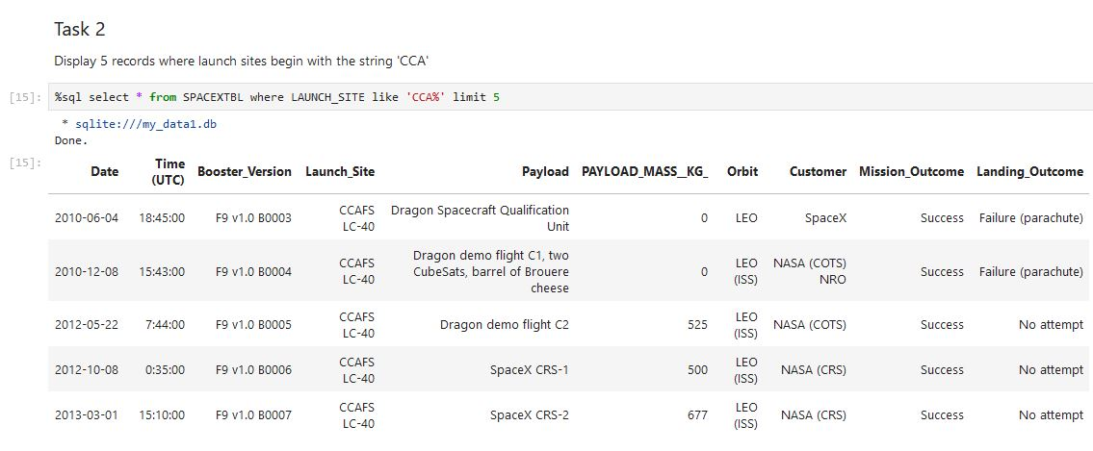
Launch Site Names Begin with 'CCA'
Find 5 records where launch sites begin with `CCA`
Present your query result with a short explanation here

Slide 26
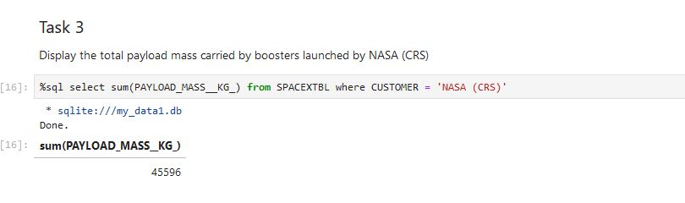
Total Payload Mass
Calculate the total payload carried by boosters from NASA
Present your query result with a short explanation here

Slide 27
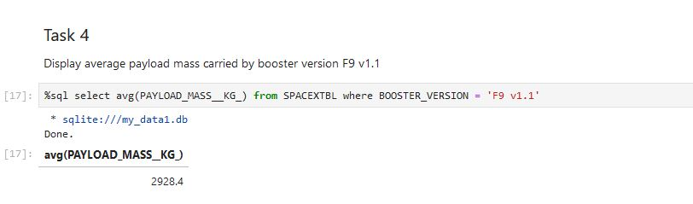
Average Payload Mass by F9 v1.1
Calculate the average payload mass carried by booster version F9 v1.1
Present your query result with a short explanation here

Slide 28
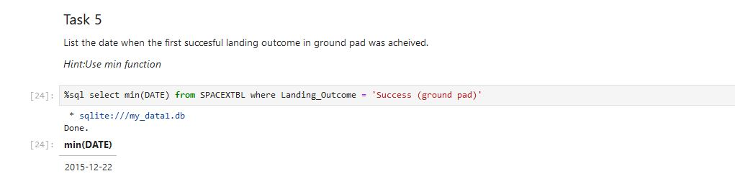
First Successful Ground Landing Date
Find the dates of the first successful landing outcome on ground pad
Use the SELECT and WHERE clause to get the exact date of the landing.
Present your query result with a short explanation here

Slide 29
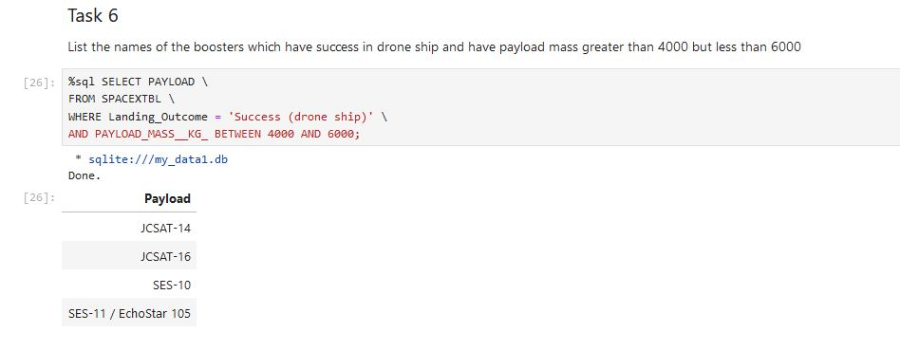
Successful Drone Ship Landing with Payload between 4000 and 6000
List the names of boosters which have successfully landed on drone ship and had payload mass greater than 4000 but less than 6000
The WHERE and AND clause was used to extract the data
Present your query result with a short explanation here

Slide 30
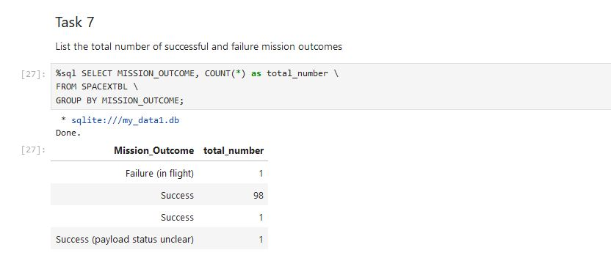
Total Number of Successful and Failure Mission Outcomes
Calculate the total number of successful and failure mission outcomes
Using the function COUNT one can count the amount of entries. But, we would like to do so with a grouping of result which is done via the GROUP BY keyword.
Present your query result with a short explanation here

Slide 31
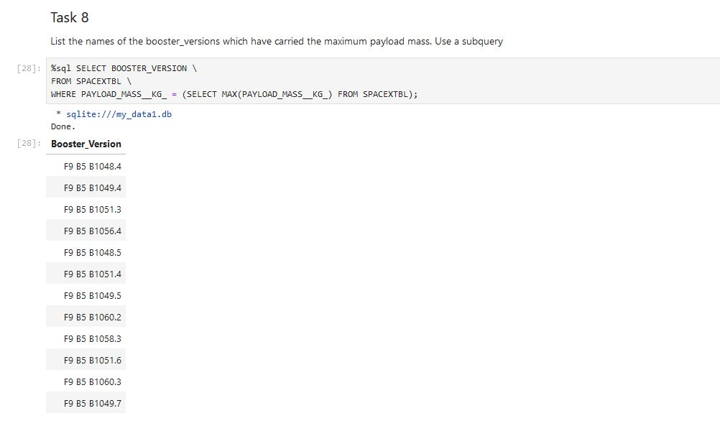
Boosters Carried Maximum Payload
List the names of the booster which have carried the maximum payload mass
Used a second query to find the maximal payload in which I used the MAX function. With this information, we can employ it in the condition part.
Present your query result with a short explanation here

Slide 32
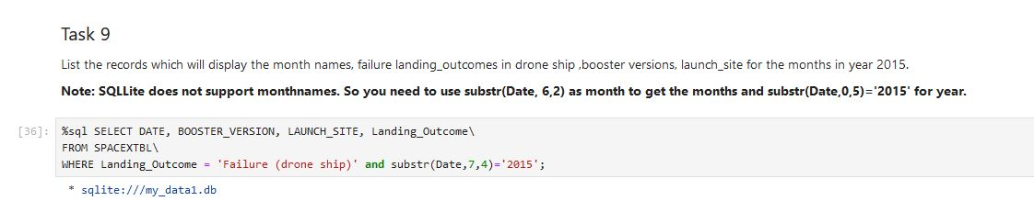
2015 Launch Records
List the failed landing_outcomes in drone ship, their booster versions, and launch site names for in year 2015
Here we use a specialty of SQLite, the substr function, i.e. it gives a substring based on an index and some length. We apply it on the date variable to extract year and month
Present your query result with a short explanation here

Slide 33
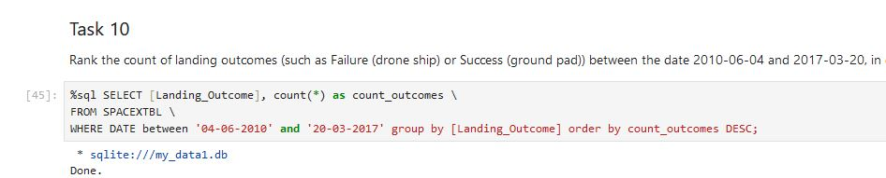
Rank Landing Outcomes Between 2010-06-04 and 2017-03-20
Rank the count of landing outcomes (such as Failure (drone ship) or Success (ground pad)) between the date 2010-06-04 and 2017-03-20, in descending order
Used the DESC keyword to get a descending list which is ordered by
the amount of landing outcomes while satisfying all other conditions
Present your query result with a short explanation here

Slide 34

Section 3

Slide 35
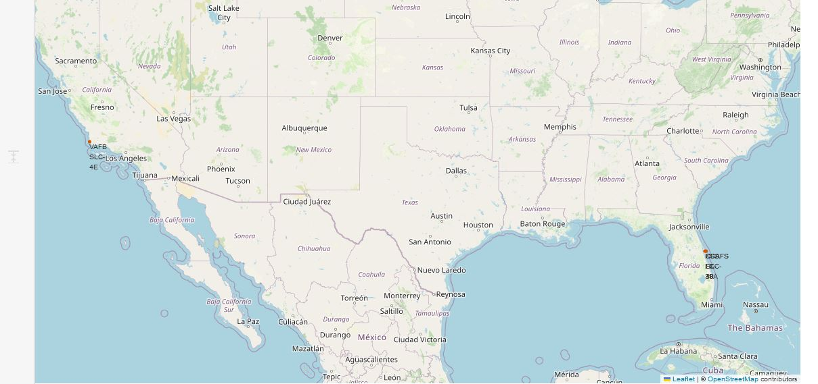
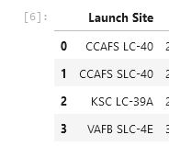
<Folium Map Screenshot 1>
Replace <Folium map screenshot 1> title with an appropriate title
Explore the generated folium map and make a proper screenshot to include all launch sites’ location markers on a global map
Launch site are located on the east and west coast of the US, precisely in Califonia and Florida
Explain the important elements and findings on the screenshot

Slide 36
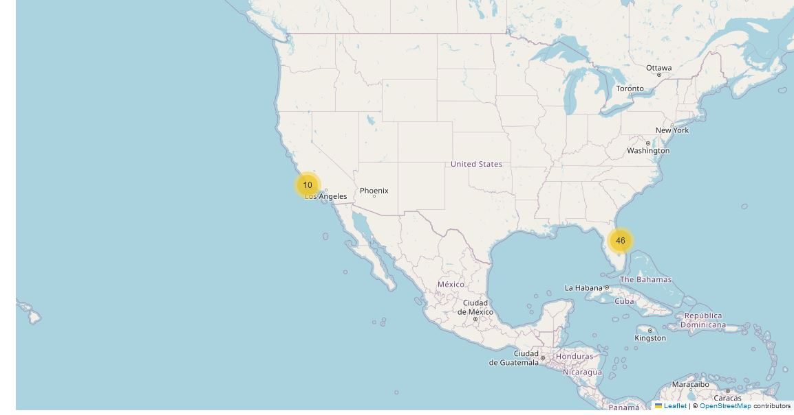
<Folium Map Screenshot 2>
Replace <Folium map screenshot 2> title with an appropriate title
Explore the folium map and make a proper screenshot to show the color-labeled launch outcomes on the map
Explain the important elements and findings on the screenshot
Added Markers to indicate success and failure at each launch site

Slide 37
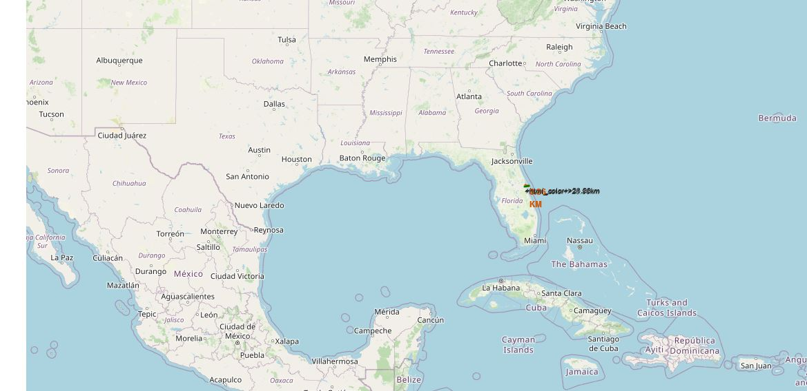
<Folium Map Screenshot 3>
Replace <Folium map screenshot 3> title with an appropriate title
launch site to its proximities such as railway, highway, coastline, with distance calculated and displayed
Launch Sites are directly at the coasts but ~ 10-15km away from the next
big city and next highway, safe enough in case of an accident
• Roughly 3000-4000km from the equator where the highest earth
rotational speed of the earth is and thus, better launch conditions

Slide 38

Section 4

Slide 39
<Dashboard Screenshot 1>
Replace <Dashboard screenshot 1> title with an appropriate title
Show the screenshot of launch success count for all sites, in a piechart
Explain the important elements and findings on the screenshot

Slide 40
<Dashboard Screenshot 2>
Replace <Dashboard screenshot 2> title with an appropriate title
Show the screenshot of the piechart for the launch site with highest launch success ratio
Explain the important elements and findings on the screenshot

Slide 41
<Dashboard Screenshot 3>
Replace <Dashboard screenshot 3> title with an appropriate title
Show screenshots of Payload vs. Launch Outcome scatter plot for all sites, with different payload selected in the range slider
Explain the important elements and findings on the screenshot, such as which payload range or booster version have the largest success rate, etc.

Slide 42

Section 5

Slide 43
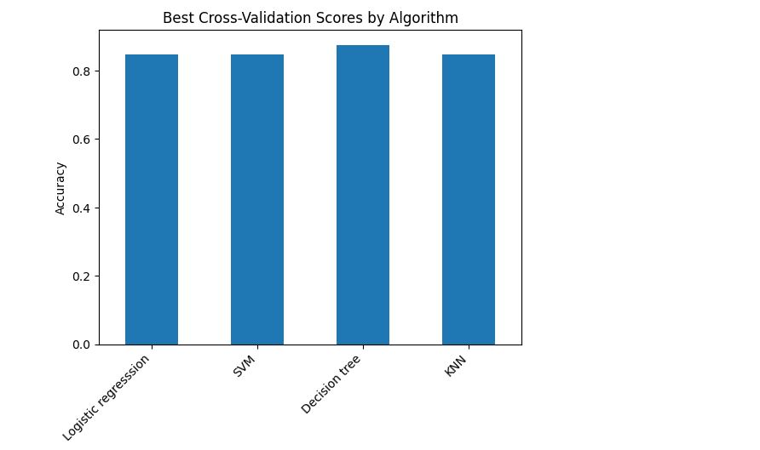
Classification Accuracy
Decision Tree Model is the best with an accuracy with around 91%
Others perform only minorly worse with
accuracy rates > 84%

Slide 44
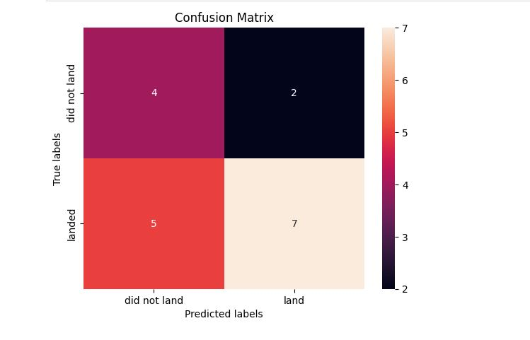
Confusion Matrix
Confusion Matrix for Decision Tree
True/false vs Land/Not Land
Matrix
Predicted landing outcomes
for the test data=subset of original data
Unfortunately, we have True/Not-Land outcomes
But, overall 15/18 correct predictions

Slide 45
Conclusions
Model Performance: The models performed similarly on the test set with the decision tree model slightly outperforming
Coast: All the launch sites are close to the coast
Launch Success: Increases over time
KSC LC-39A: Has the highest success rate among launch sites. Has a 100% success rate for launches less than 5,500 kg
Orbits: ES-L1, GEO, HEO, and SSO have a 100% success rate
Payload Mass: Across all launch sites, the higher the payload mass (kg), the higher the success rate

Slide 46
Appendix
Dataset: A larger dataset will help build on the predictive analytics results to help understand if the findings can be generalizable to a larger data set
Feature Analysis / PCA: Additional feature analysis or principal component analysis should be conducted to see if it can help improve accuracy
XGBoost: Is a powerful model which was not utilized in this study. It would be interesting to see if it outperforms the other classification models

Slide 47


